Slide 1
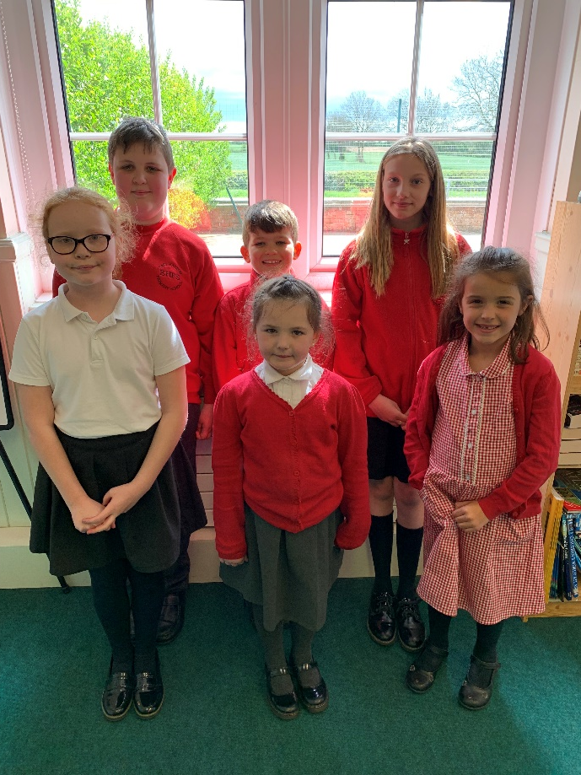
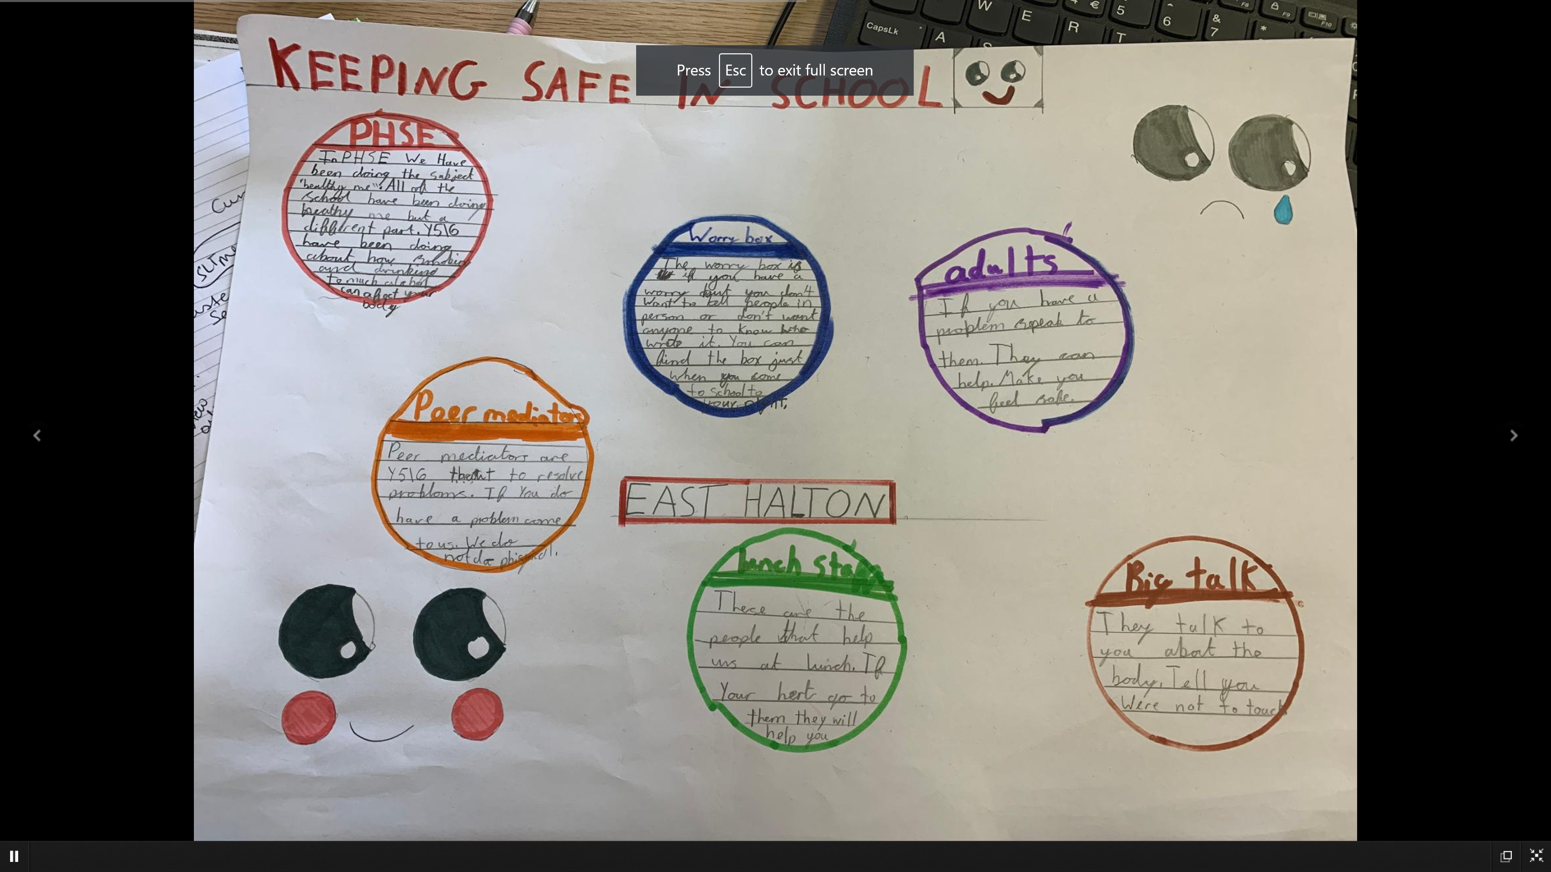
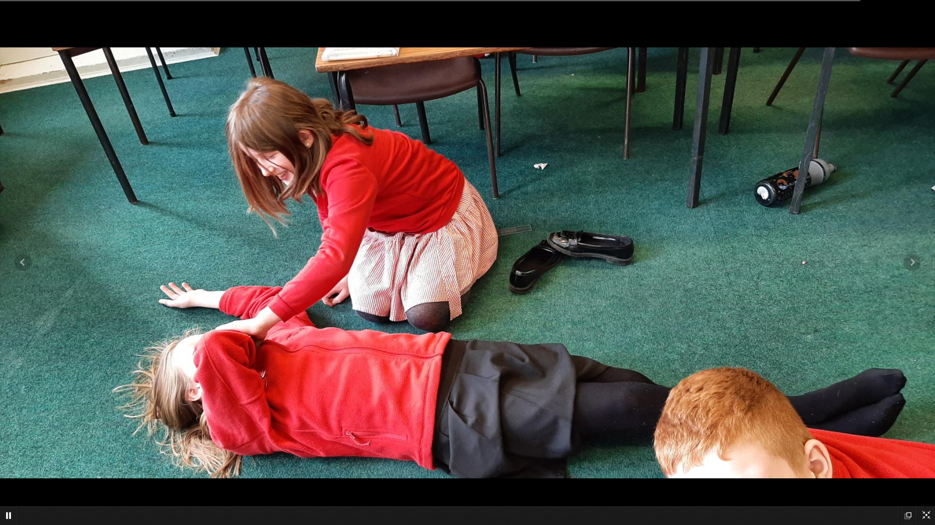
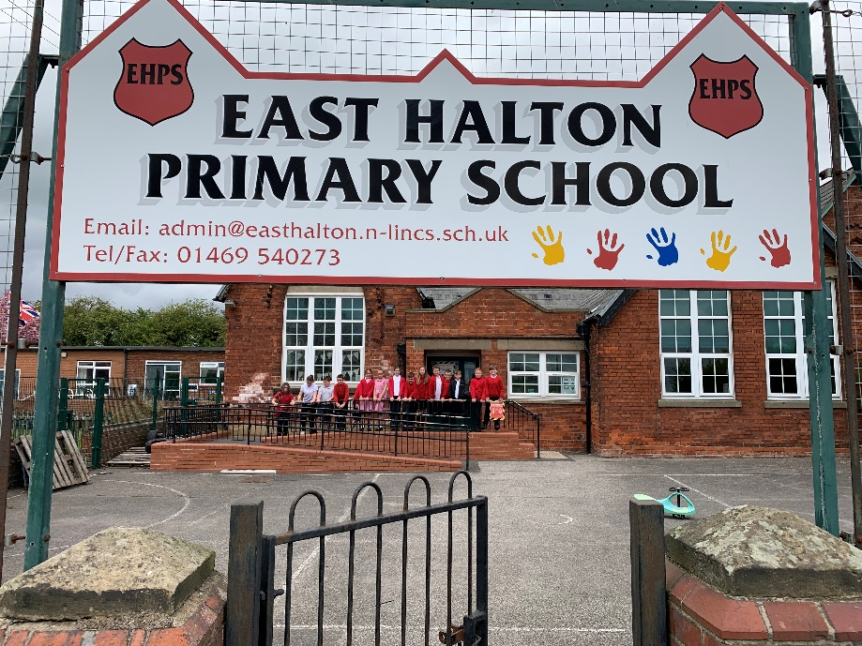
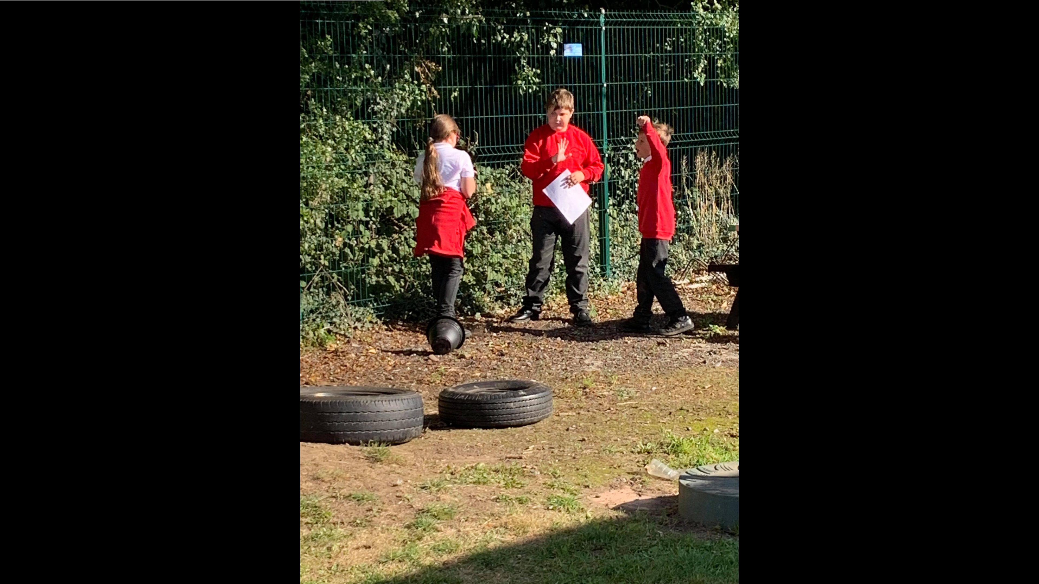
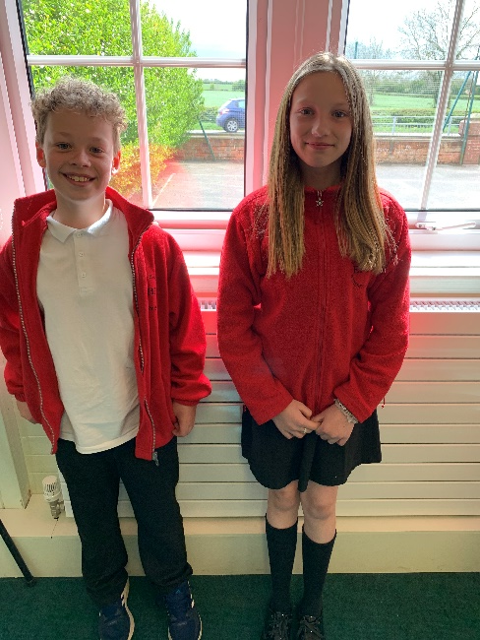
What does school do to keep you safe?
Notes:
How does school keep us safe? Ask children and collect answers.

Slide 2
If you have any questions, put up your hand to discuss them with your teacher.

Slide 3

E-Safety Day
E-Safety Day teaches us lots of things:
https://www.childline.org.uk
If you post something online or on the internet, it can be copied and shared so even if you delete it, it is still there.
To be respectful online when gaming (this is one of our core expectations).
It helps us know why age limits are important and why they are there. (Parental controls need to be in place)
That we need to tell a trusted adult if anything worries or scares us on the internet.
What to do in difficult situations.
If you say unkind things online, it can really hurt somebody’s feelings but you cannot see them to know.
How to keep safe on the internet (e.g don’t give away personal information).
Bullying online is called cyberbullying.
Notes:
How does internet safety keep us safe?
(Show the answers)
There are thousands of websites on the internet if you ever feel like you cannot talk to a trusted adult. Childline is the most known website so you can talk to people about your problems instead of keeping them to yourself. A problem shared is a problem halved.

Slide 4
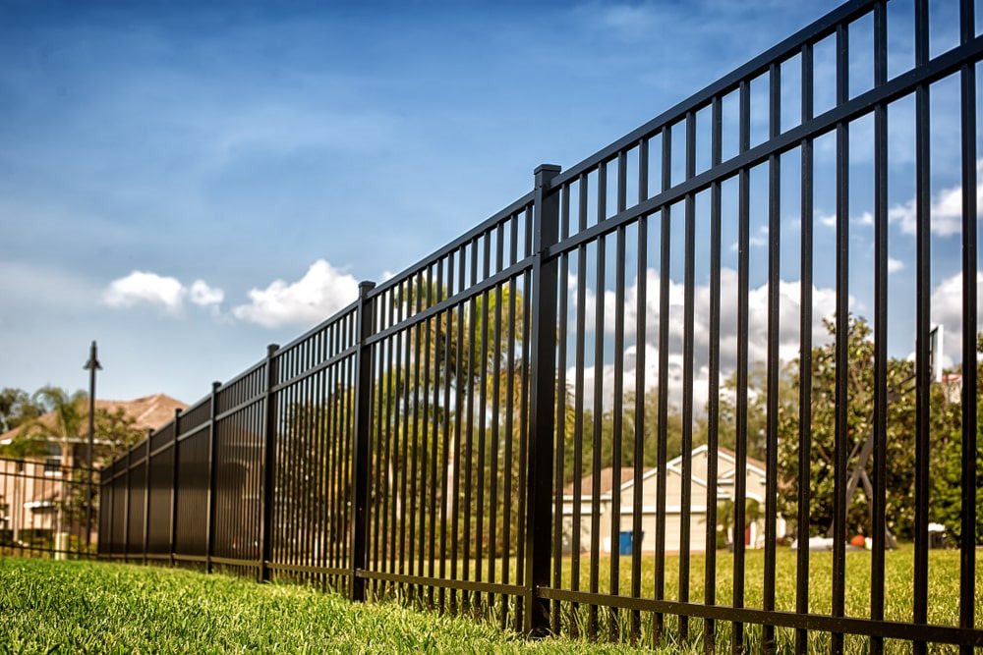
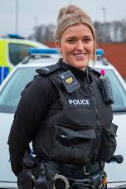
People in school/fences
Gates keep people we do not know out so we are safe. (strangers)
Teachers are police checked to make sure they are safe to work with children. Teachers and other adults in school are trusted adults.
Gates are important because they keep children in; if they left the school site, they could get lost or hurt.
Gates also stop animals coming into the school so that children do not get hurt. This also stops them from damaging our school environment. (We have the odd cat and chicken)
Visitors coming into school wear badges . This shows us that they are allowed to be in school.
Staff in school have first aid training. We have visits from the local PCSO.
Notes:
What are police checks?
A police check is where anyone in contact with children is checked by the police so they are able to work with them.
How do police checks and gates keep us safe?
(Reveal answers)

Slide 5
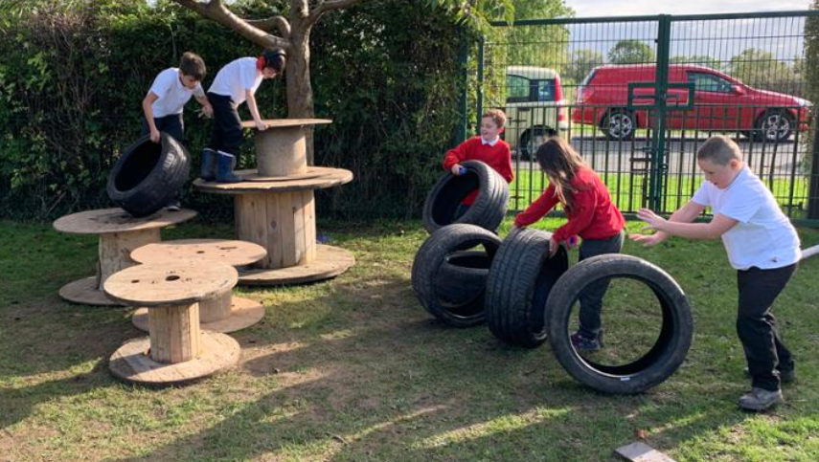
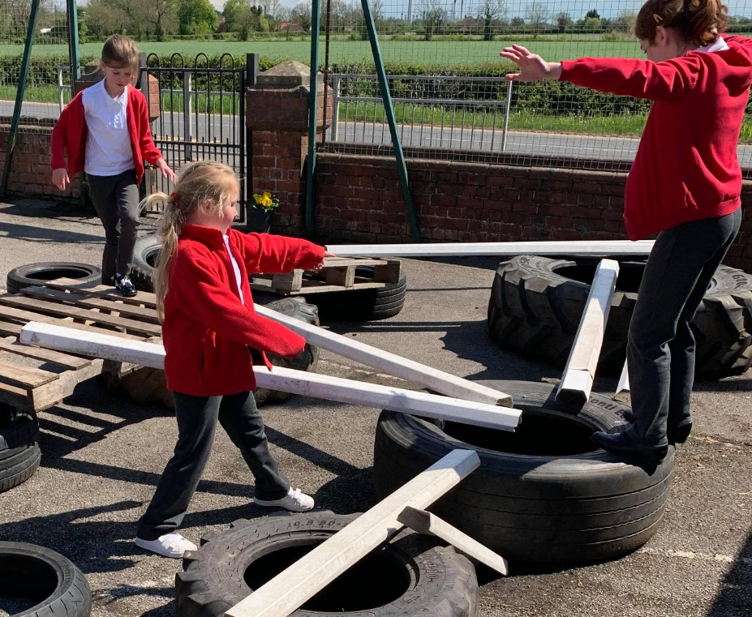
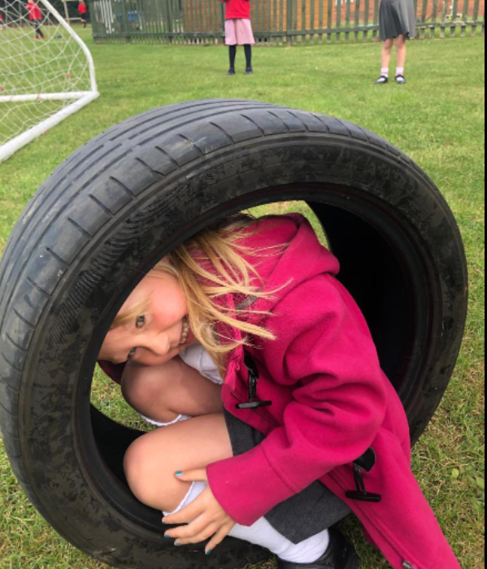
Playground safety
If you have any problems, Year 5 and 6 are qualified peer mediators and we can help you tackle any kind of problem which happens in school. We help you to find solutions and resolve any problems.
Our Play equipment is checked daily by staff to keep our playground and us safe. Our trim trails and climbing equipment is checked by external providers once a year and weekly by our caretakers.
Children also report any breakages.
Playtime staff look out for us and they make sure we don’t get injured on the playground. Teachers also create boundaries to keep us safe – we need suitable footwear at school.
Safety monitors have been appointed and their role will be specifically to monitor and report any health and safety issues around school.
We are allowed healthy snacks at morning break time.
As part of OPAL, we risk assess to ensure our safety when trying new things. –
Notes:
Do you think our playground is safe? What could we do to make it safer? Share the slide. Have you ever been peer mediated? Could you try going to a peer mediator before going to a trusted adult?

Slide 6
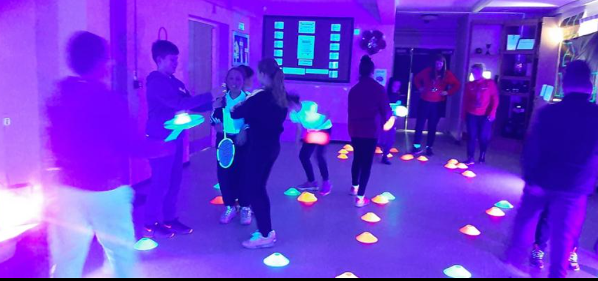
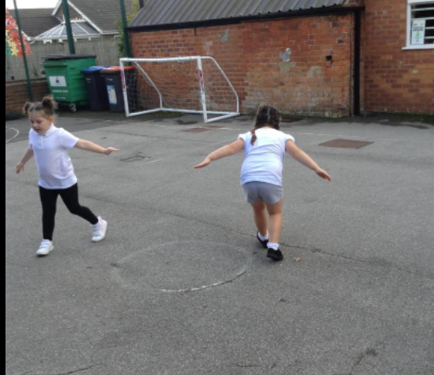
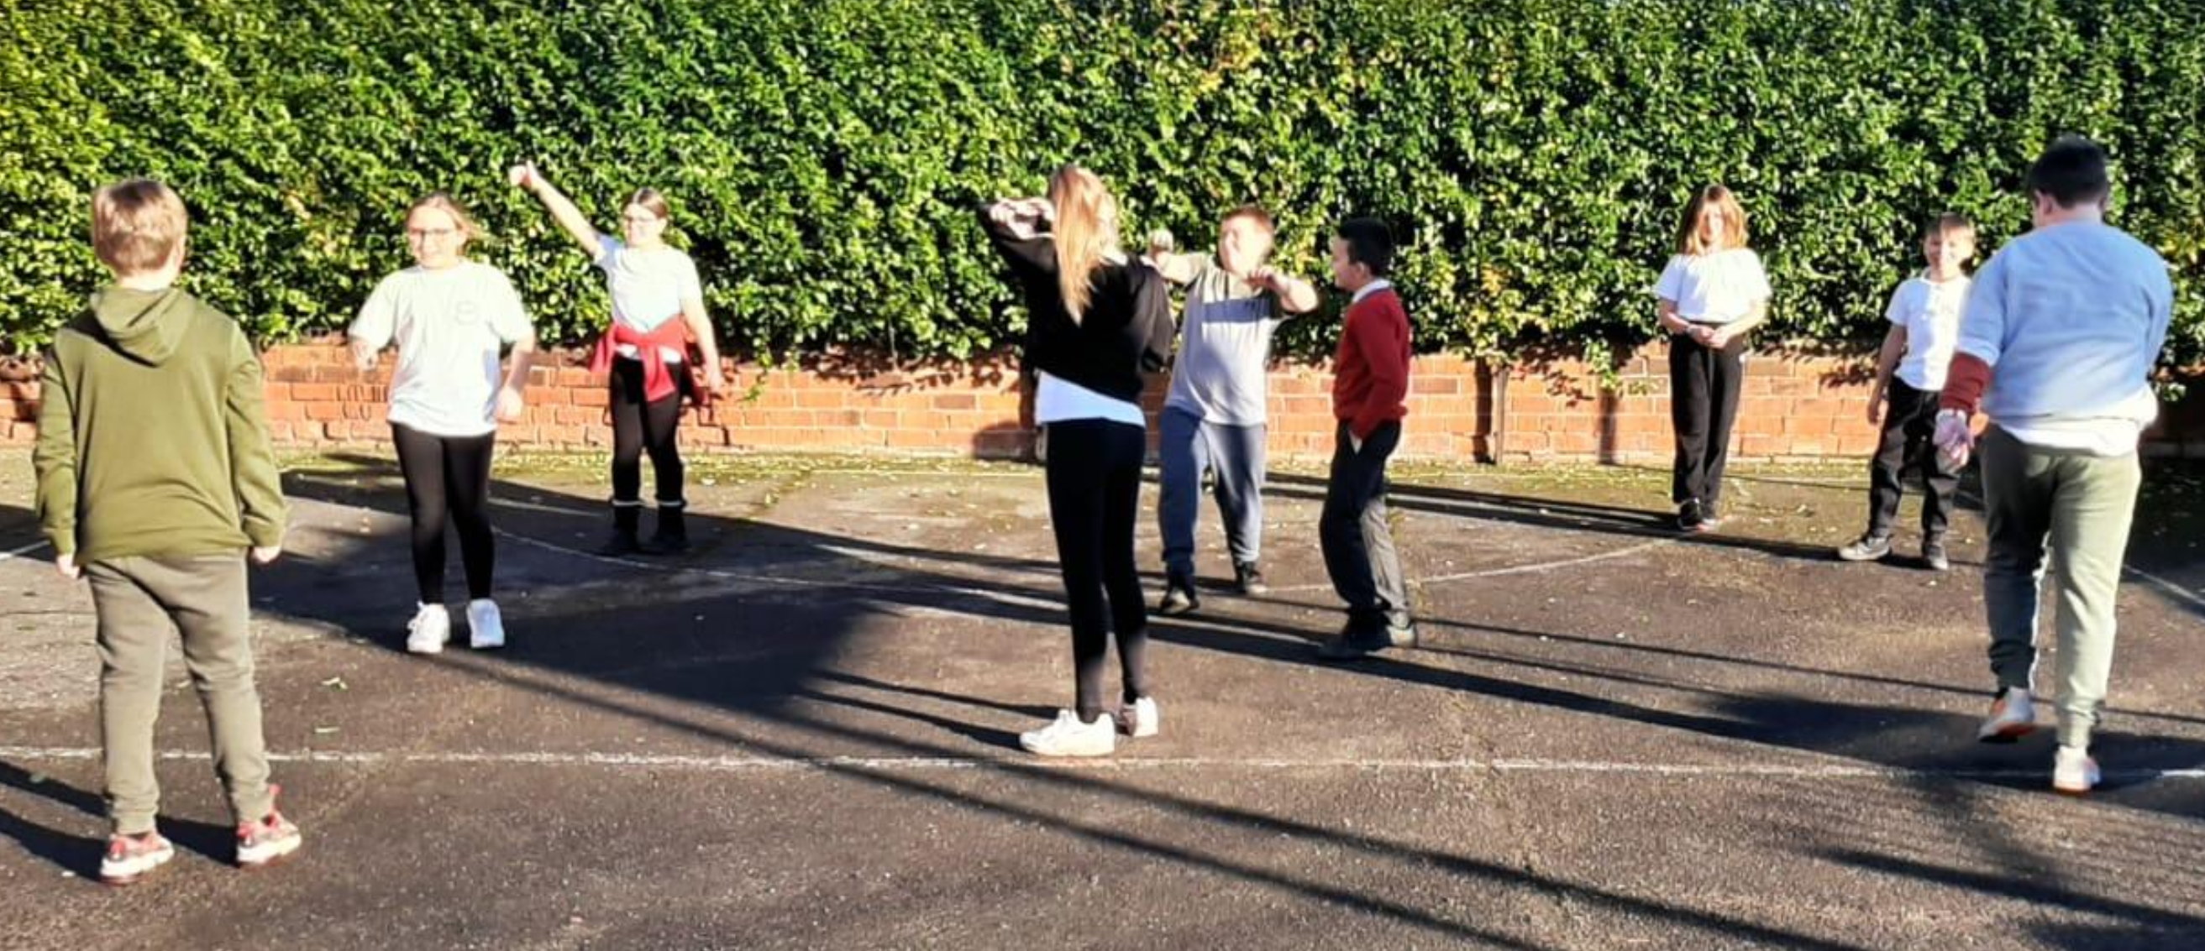
PE Safety
Cycling proficiency help us to be safe on the road outside of school when we are with our friends and families.
In Lower Key Stage 2, you learn how to swim and be safe in water. This is an important life skill.
Warm-ups in PE keep you safe because if you do not do them, you could strain or pull a muscle.
In Lower Key Stage 2 we complete a pedestrian training course which also helps keep us safe on the roads.
Notes:
What do we do in PE to keep us safe?

Slide 7
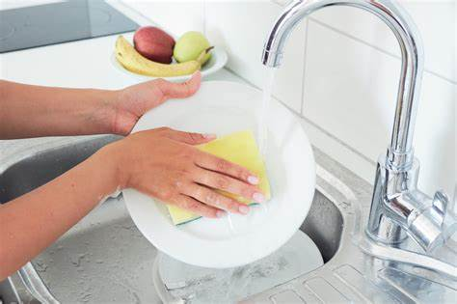
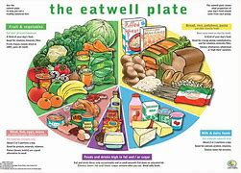
Hygiene and allergies
Kitchen staff are aware of individual food allergies so they provide different meals to those who have them if needed. We also don’t allow nuts on the school site in case children or adults have an intolerance.
All teaching staff are required to undertake a Food Hygiene Course before teaching DT
Our kitchen staff follow all of the food hygiene rules to keep us safe: they wash their hands, tie their hair back, store and dispose of food correctly.
After washing up plates and bowls, the kitchen staff sterilise the equipment to kill all leftover germs. They provide a balanced diet throughout the week to keep us and our bodies healthy.
Every night, the caretaker cleans the school to get rid of any germs and keep us safe.
The caretaker looks after the school and fixes anything that is broken to stop us getting hurt.
Notes:
How do kitchen staff stay safe when cooking? Do they provide a balanced diet?

Slide 8
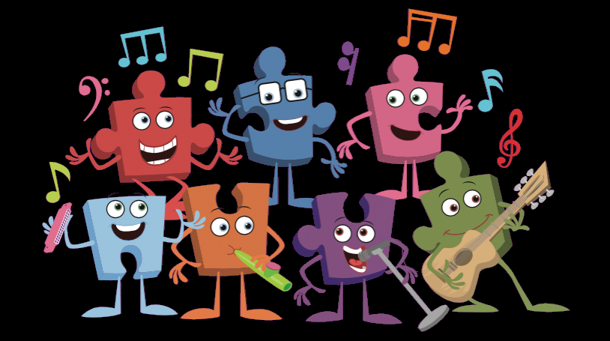

Big talk and Anti-bullying/PSHE
PSHE keeps us safe because it teaches us how to keep our bodies clean and healthy, be kind to each other, celebrate each other’s differences, have good personal hygiene and also maintain a balanced diet. It teaches us to care about what happens, not just in our community, but in other communities and other countries .We learn to have empathy for others.
Anti-Bullying keeps us safe because when people are bullied it affects them both mentally and physically. If people don’t tell a trusted adult, they will become sad. Bullying needs to be stopped before it becomes serious!
Big Talk keeps us safe by helping us understand different body parts. They also tell us what is appropriate and inappropriate to do with our bodies. It also teaches us about healthy relationships.
Notes:
Do you enjoy PSHE? Do you think it keeps us safe?

Slide 9

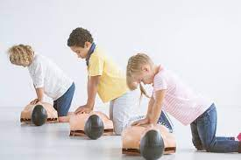
PSHE Continued…
The ‘With Me in Mind’ organisation works within school to deliver workshops and support children emotionally, mentally, socially and physically. We have appointed ‘Well- being’ ambassadors from Year 5 and 6 who will give support and encouragement to the rest of the children in school.
In Key Stage 2, we all complete a Mini First Aid training course which helps us to know what to do in an emergency and helps us to keep ourselves and each other safe.

Slide 10
Rules
Rules keep us safe by telling us what to do; they make sure we don’t become ill or injure ourselves. Rules help us learn what are the right and wrong choices. If you don’t shout out in class, you will have more time to learn. School helps us to become better people and to prepare us for the wider world.
Ready…
Respectful…
Safe …
The school council enables you to have your say on what our school needs to do to keep us safe.
Our Head Boy and Girl work hard to help represent our school when we have visitors and also help support the children to make good choices.
Notes:
What are our core school expectations? Can you give examples of what this looks like?
WE ARE READY
This means that…
We come to school with a positive mind-set
We always show a ‘can do’ attitude
We bring the equipment we need for our school day
We wear the correct uniform and footwear
We show good looking and good listening
We are always on task
WE ARE RESPECTFUL
This means that…
We celebrate and value others,
We use good manners with everyone in our school community
We make sure that we learn and allow others to learn
We participate fully in every lesson
We listen carefully and follow instructions
We look after our belongings and school property
WE ARE SAFE
This means that…
We keep ourselves and others free from harm in school, in our community and online
We recognize safe and unsafe behaviours
We tell a trusted adult when we are worried or if we have a concern
We use kind hands, kind words and kind feet

Slide 11
Can you think of any other way school keeps us safe?
Any questions?
We take turns
We don’t litter our environment
Buddy bench
We look out for each other
We have created rules at playtime for safety (x2 children in the tree)
Notes:
Friends, taking turns on equipment

